Slide 1
Fundamentals of Electric Transmission System Planning
Talk 11: Power System Optimization and Locational Marginal Prices
Prof. Tom Overbye
Dept. of Electrical and Computer Engineering
Texas A&M University
overbye@tamu.edu

Slide 2
Power System Economics
With the traditional vertically integrated utility the electric grid was planned holistically with the goal of minimizing total costs while meeting some desired level of reliability (and perhaps resiliency)
With deregulation and open access the risk has moved to at least somewhat to independent generation companies
Planning has moved from a single utility to potentially a large number of players with different goals
Different generation technologies can have vastly different costs, especially when considering capital versus operating costs

Slide 3
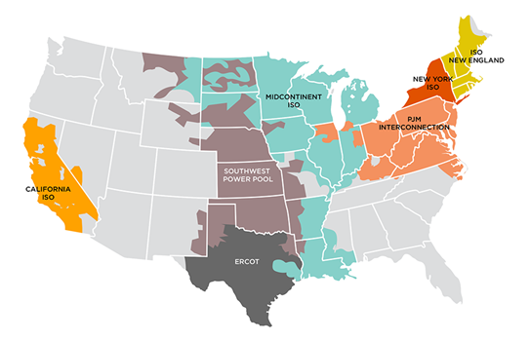
Power System Markets
In North America several electricity markets have developed, many using locational marginal prices (LMPs)
This section covers the basics of power system optimization from a planning perspective
Image source: FERC

Slide 4
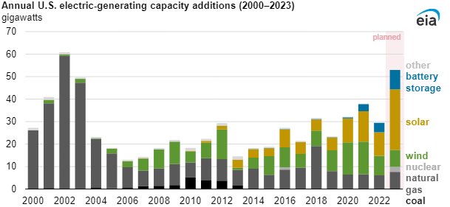
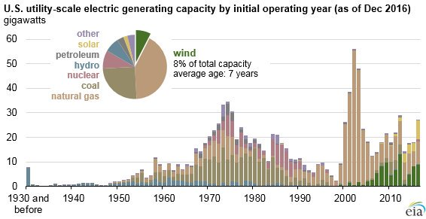
US Generator Capacity Additions
These have been driven the a number of issues including CO2 emissions, natural gas prices, nuclear concerns, and decreasing costs for wind, solar and storage

Slide 5
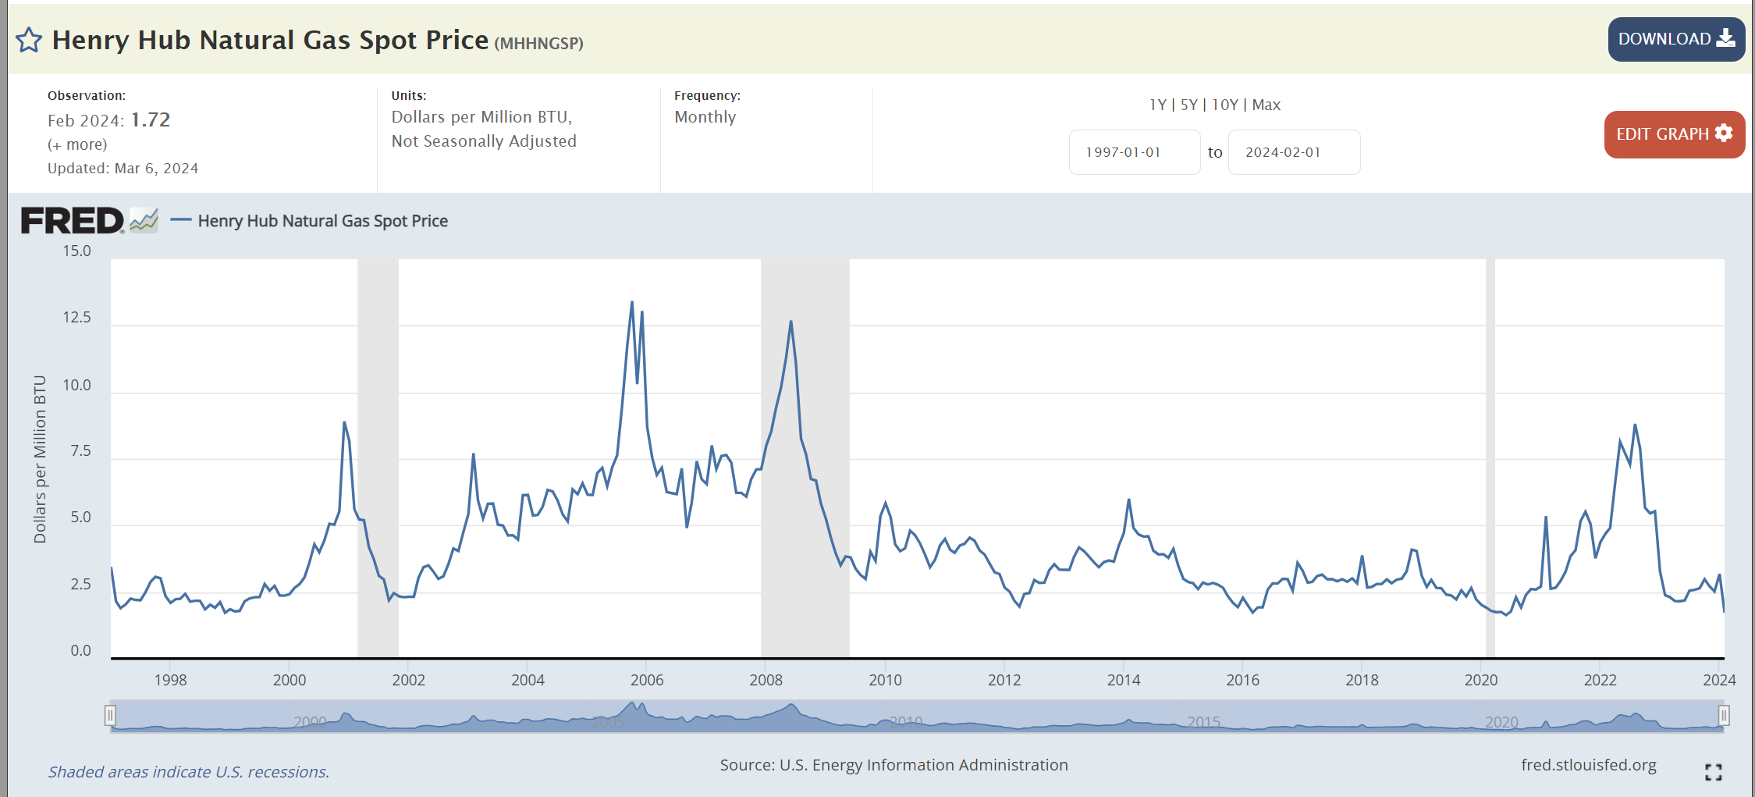
Natural Gas Prices
A key driver of electric grid economics is natural gas prices

Slide 6
Power System Operational Economics
Generators can have vastly different incremental operational costs
Some are essentially free or low cost (wind, solar, hydro, nuclear)
Because of the large amount of natural gas generation, electricity prices are very dependent on natural gas prices
Economic dispatch is concerned with determining the best dispatch for generators without changing their commitment
Unit commitment focuses on optimization over several days.

Slide 7
Unit Commitment: Quick Coverage
Unit commitment is used to determine which generator units should be committed to meet the load
The electric load varies substantially so there is almost always more generator capacity available than load
Units have availability constraints
Minimum up time, time to start, cost to start
Minimum down time, time to shutdown, cost to shutdown
Ramp rates, minimum MW output
Scheduled and unscheduled outages
System constraints including load, reserve, emissions, network can all be considered
6

Slide 8
Solving Unit Commitment
Unit commitment involves a potentially large number of integer and continuous variables
Not just the status of each unit, but also the amount of time it has been in a particular state (i.e., off or on)
Solved for a set of discrete time periods, which at each time period there are lots of different potential states
Solution approaches include
Dynamic programming
Lagrangian relaxation
Mixed Integer Programming (currently state-of-the-art)
7

Slide 9
Longer Term Optimization
Longer term optimization is a key consideration in hydro systems with significant reservoir storage
Use the water when it is the most valuable taking into account potentially many other constraints
Generator maintenance scheduling
Building generation often involves large upfront capital costs to create an asset that will last 20 to 40 years; long-term contracts provide a way to share the risk
Take-or-pay contracts obligate a purchaser to purchase so much of a product over a given time period
8

Slide 10
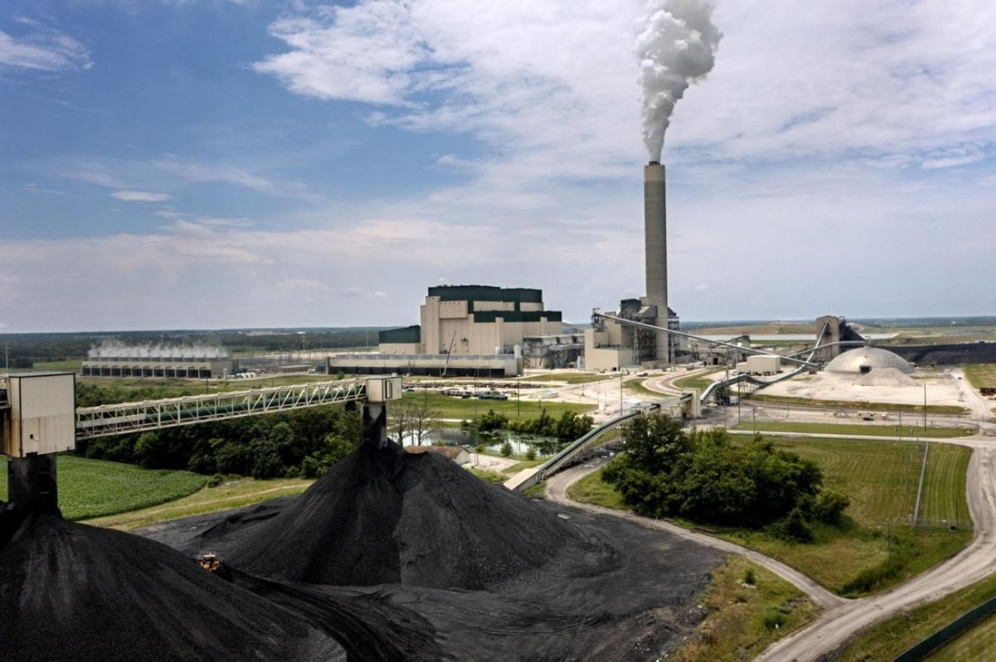
Example: Prairie State Energy Campus
The Prairie State Energy Campus (PSEC) is a 1600 MW coal plant in Southern Illinois with its own coal mine that opened in 2012
It is owned by municipals and coops (my former coop got >60% of the energy from PSEC)
While relatively efficient, it is one of the US’s largest sources of CO2 emissions
It cost an estimate $4 billion to build; if it sells its power at $30/MWh then maximum yearly income would be $30*1600*8760=$420 million
Illinois’s new clean energy law requires PSEC to reduce carbon emissions by 45% by 1/1/35 and be 100% carbon free by the end of 2045
Image: Pantagraph.com
9

Slide 11
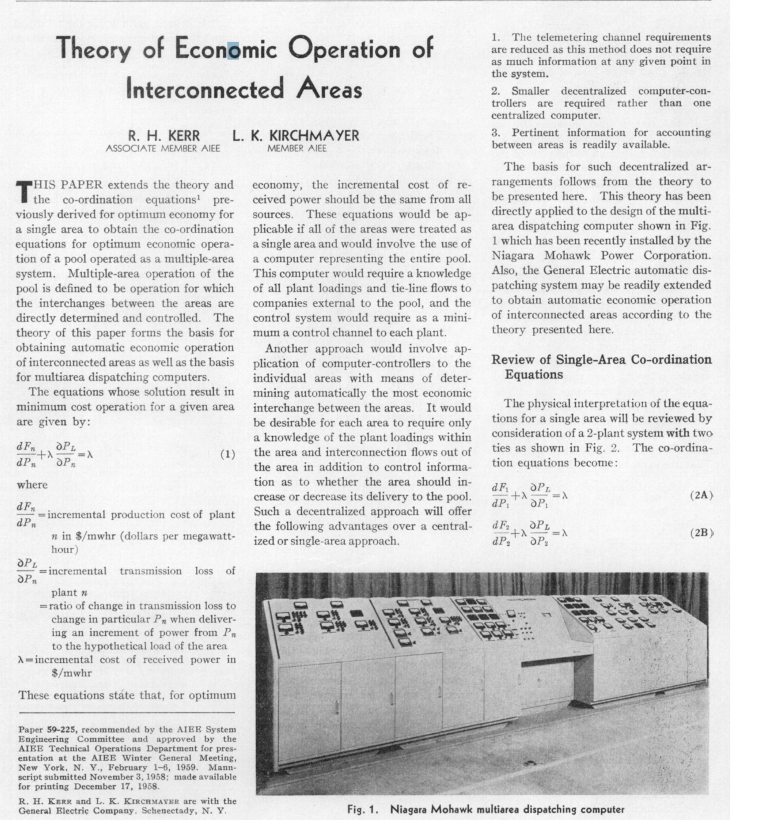
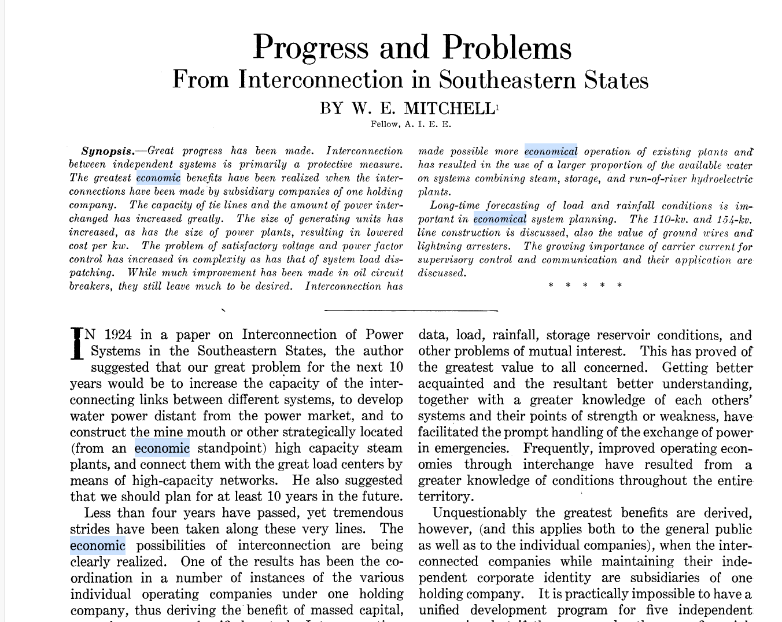
Electric Grid Economic Operation
Electric grid operations have been optimized for many decades!
1928
1958

Slide 12
Power System Economic Dispatch
Economic dispatch is a constrained minimization
The cost function is often generation cost in an area
Single equality constraint is the real power balance
Solved by setting up the Lagrangian (with P_{D} the load and P_{L} the losses)
A necessary condition for a minimum is that the gradient is zero. Without losses this occurs when all generators are dispatched at the same marginal cost (except when they hit a limit)
The marginal (or incremental) cost tells how much it would cost to produce one more MW for an hour ($/MWh)

Slide 13
Economic Dispatch Example without Losses
To include the marginal impact of losses, select Simulator Options, Power Flow Solution, Advanced Options Page then check Include Loss Penalty Factors in ED
Case is B5_EconomicDispatch
12

Slide 14
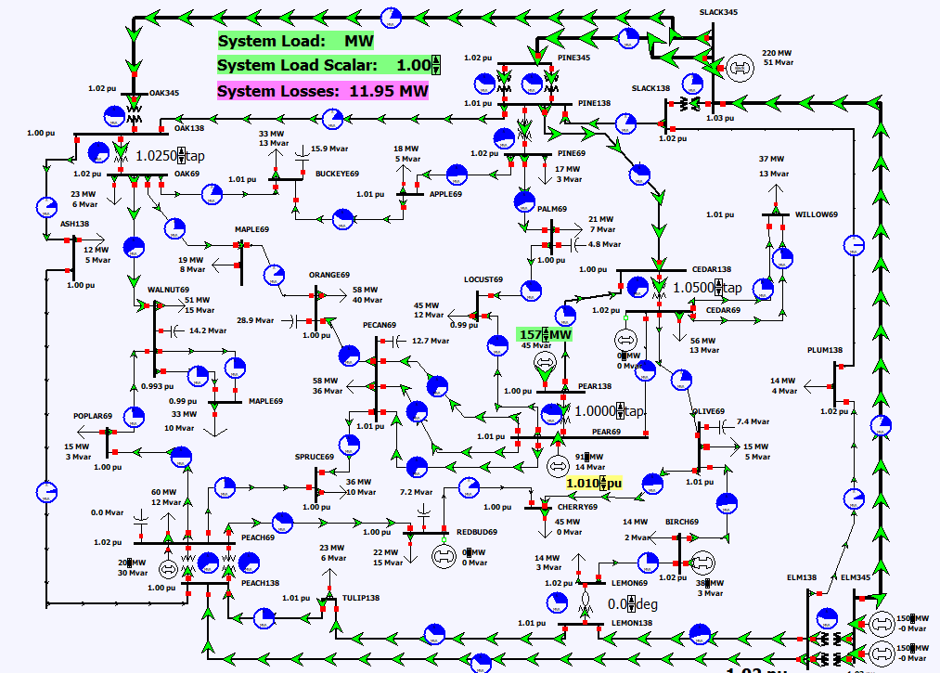
Economic Dispatch on 37 Bus Case
To see economic dispatch on the 37 bus case, open case PSC_37Bus_EconomicDispatch; to see a graph of the generator costs right-click on any generator and select Curves, All Area Gen IC Curves

Slide 15
Area Supply Curve
The area supply curve shows how the marginal cost for an area (or the entire case) varies assuming an economic dispatch
The curves for an area or super area are available in their case information displays by right-clicking and selecting Plot then one of its options
This is a quick way to get an overall feel for a case
Texas2000 Supply Curve
PSC_37Bus Supply Curve

Slide 16
Optimal Power Flow (OPF)
OPF functionally combines the power flow with economic dispatch
SCOPF adds in contingency analysis
Goal of OPF and SCOPF is to minimize a cost function, such as operating cost, taking into account realistic equality and inequality constraints
Equality constraints
bus real and reactive power balance
generator voltage setpoints
area MW interchange
15

Slide 17
OPF, cont.
Inequality constraints
transmission line/transformer/interface flow limits
generator MW limits
generator reactive power capability curves
bus voltage magnitudes (not yet implemented in Simulator OPF)
Available Controls
generator MW outputs
transformer taps and phase angles
reactive power controls
16

Slide 18
Two Example OPF Solution Methods
Non-linear approach using Newton’s method
handles marginal losses well, but is relatively slow and has problems determining binding constraints
Generation costs (and other costs) represented by quadratic or cubic functions
Linear Programming
fast and efficient in determining binding constraints, but can have difficulty with marginal losses.
used in PowerWorld Simulator
generation costs (and other costs) represented by piecewise linear functions
Both can be implemented using an ac or dc power flow
17

Slide 19
Key SCOPF Application: Locational Marginal Prices (LMPs)
When OPF includes contingency analysis it is know as the Security-Constrained OPF (SCOPF)
OPF dates back to 1960’s with thousands of papers
The locational marginal price (LMP) tells the cost of providing electricity to a given location (bus) in the system
Concept introduced by Schweppe in 1985
F.C. Schweppe, M. Caramanis, R. Tabors, “Evaluation of Spot Price Based Electricity Rates,” IEEE Trans. Power App and Syst., July 1985
LMPs are a direct result of an SCOPF, and are widely used in many electricity markets worldwide both ahead and in real-time
The exact calculations are market specific
18

Slide 20
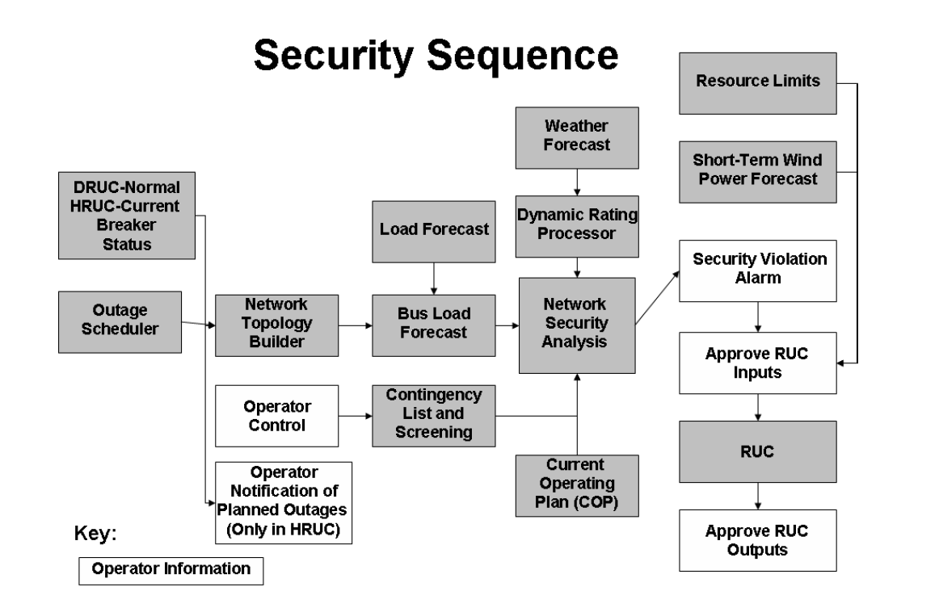
Example: ERCOT Security Sequence
The ERCOT Nodal Protocols document (latest July 2022) details the process used by ERCOT
RUC is Reliability Unit Commitment
DRUC is the Day-Ahead Reliability Unit Commitment
HRUC is the Hourly Reliability Unit Commitment

Slide 21
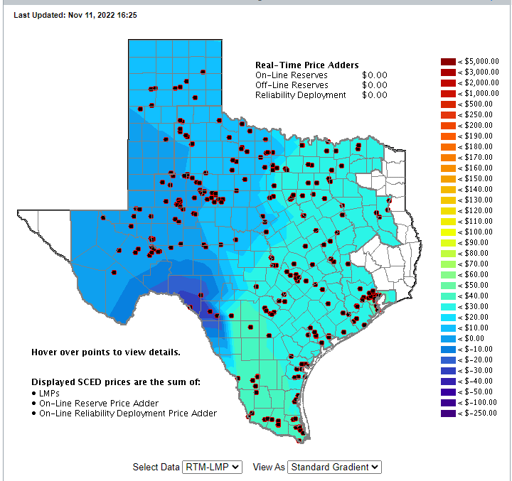
ERCOT LMPs, March 15, 2024 at 4:25 pm
20

Slide 22
OPF Problem Formulation
The OPF is usually formulated as a minimization with equality and inequality constraints where x is a vector of dependent variables (such as the bus voltage magnitudes and angles), u is a vector of the control variables, F(x,u) is the scalar objective function, g is a set of equality constraints (e.g., the power balance equations) and h is a set of inequality constraints (such as line flows)

Slide 23
LP OPF Solution Method
Solution iterates between
solving a full ac or dc power flow solution
enforces real/reactive power balance at each bus
enforces generator reactive limits
system controls are assumed fixed
takes into account non-linearities
solving a primal LP
changes system controls to enforce linearized constraints while minimizing cost

Slide 24
Two Bus with Unconstrained Line
With no overloads the OPF matches
the economic
dispatch
Transmission line is not overloaded
Marginal cost of supplying power to each bus (locational marginal costs)
23

Slide 25
Two Bus with Constrained Line
With the line loaded to its limit, additional load at Bus A must be supplied locally, causing the marginal costs to diverge.
24

Slide 26
Three Bus (B3) Example
Consider a three bus case (Bus 1 is system slack), with all buses connected through 0.1 pu reactance lines, each with a 100 MVA limit
Let the generator marginal costs be
Bus 1: 10 $ / MWhr; Range = 0 to 400 MW
Bus 2: 12 $ / MWhr; Range = 0 to 400 MW
Bus 3: 20 $ / MWhr; Range = 0 to 400 MW
Assume a single 180 MW load at bus 2
25

Slide 27
B3 with Line Limits NOT Enforced
Line between Bus 1and Bus 3 is overloaded;
all buses have the same
marginal cost
26

Slide 28
B3 with Line Limits Enforced
LP OPF changes generation to remove violation.
Bus marginal
costs are now
different.
27

Slide 29
Verify Bus 3 Marginal Cost
One additional MW
of load at bus 3
raised total cost by
14 $/hr, as G2 went
up by 2 MW and G1
went down by 1MW
28

Slide 30
Why is bus 3 LMP = $14 /MWh
All lines have equal impedance. Power flow in a simple network distributes inversely to impedance of path.
For bus 1 to supply 1 MW to bus 3, 2/3 MW would take direct path from 1 to 3, while 1/3 MW would “loop around” from 1 to 2 to 3.
Likewise, for bus 2 to supply 1 MW to bus 3, 2/3MW would go from 2 to 3, while 1/3 MW would go from 2 to 1to 3.
29

Slide 31
Why is bus 3 LMP $ 14 / MWh, cont’d
With the line from 1 to 3 limited, no additional power flows are allowed on it.
To supply 1 more MW to bus 3 we need
ΔP_{G1} + ΔP_{G2} = 1 MW
2/3 Δ P_{G1} + 1/3 Δ P_{G2} = 0; (no more flow on 1-3)
Solving requires we up P_{G2} by 2 MW and drop P_{G1} by 1 MW -- a net increase of $24 – $10 = $14.
30

Slide 32
Both lines into Bus 3 Congested
For bus 3 loads
above 200 MW,
the load must be
supplied locally.
Then what if the
bus 3 generator
opens?
31

Slide 33
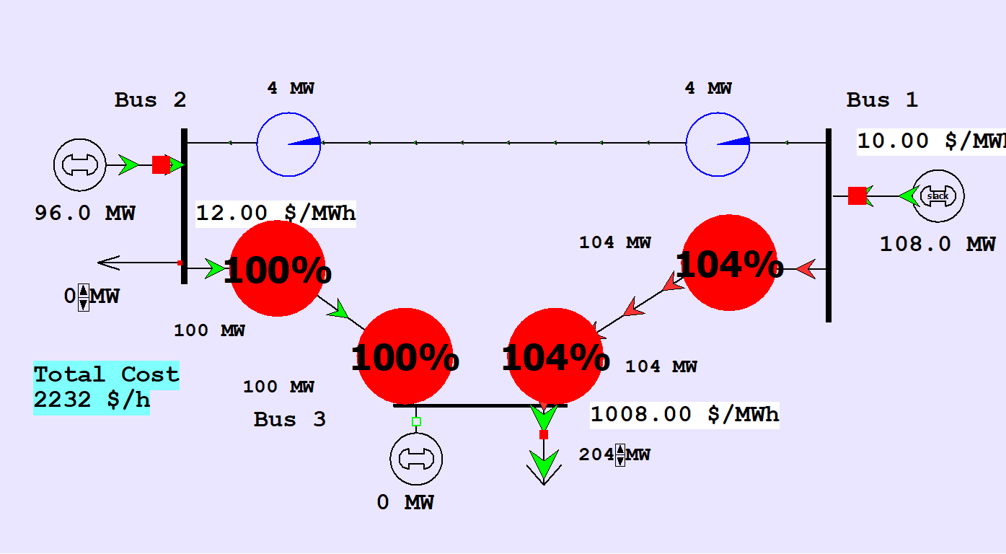
Both lines into Bus 3 Congested
An infeasible example can be created by opening the generator at Bus 3 with the Bus 3 load above 200 MW. There is no way to serve the load without overloading a transmission line.
32

Slide 34
Marginal Cost of Constraint Enforcement
In an LP solution the marginal costs of enforcing each constraint are provided by the λ vector
Marginal costs are only associated with enforcing binding constraints; inequality constraints that are not binding have no associated cost
If there are no binding limit constraints, then the only constraint is associated with the power balance for each area (or the whole system)
The bus costs might be different because of the impact of marginal losses

Slide 35
Locational Marginal Prices (LMPs)
In an OPF solution, the bus LMPs tell the marginal cost of supplying electricity to that bus
The term “congestion” is used to indicate when there are elements (such as transmission lines or transformers) that are at their limits; that is, the constraint is binding
Without losses and without congestion, all the LMPs would be the same
Congestion or losses causes unequal LMPs
The LMPs are calculated using the marginal costs of enforcing each constraint

Slide 36
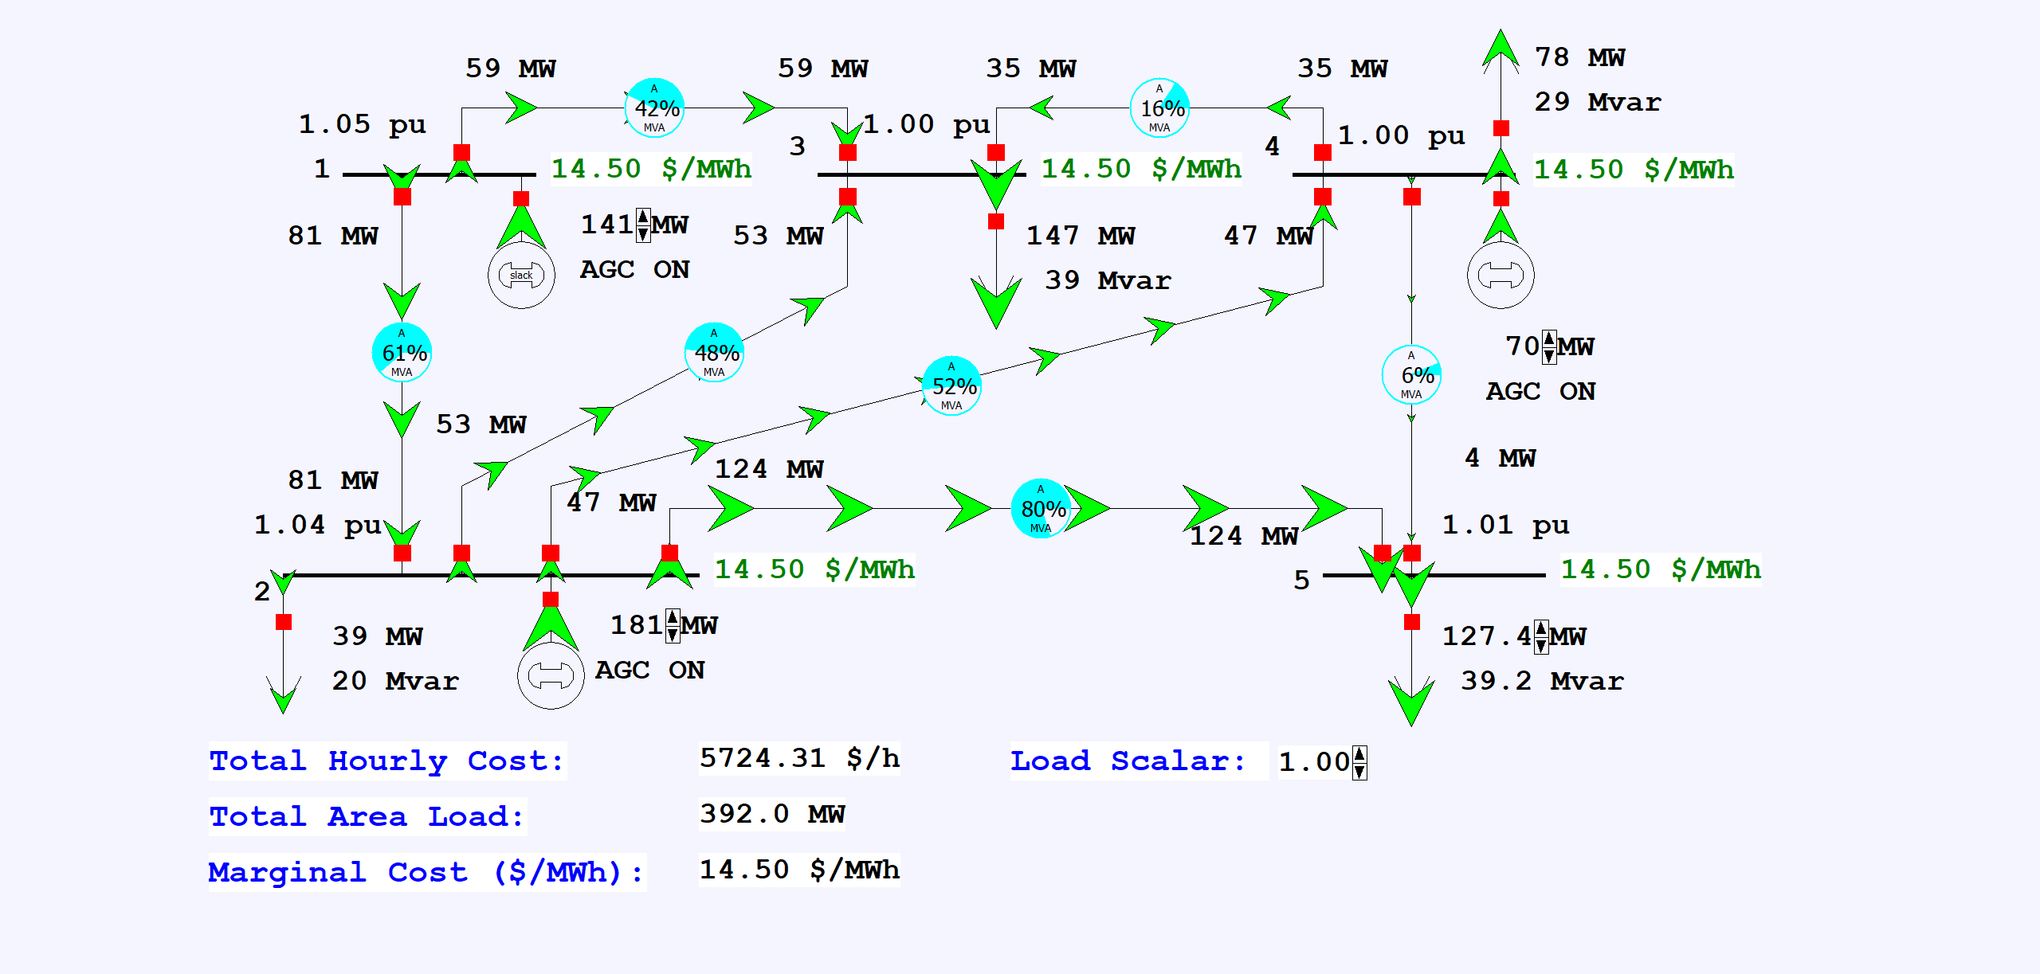
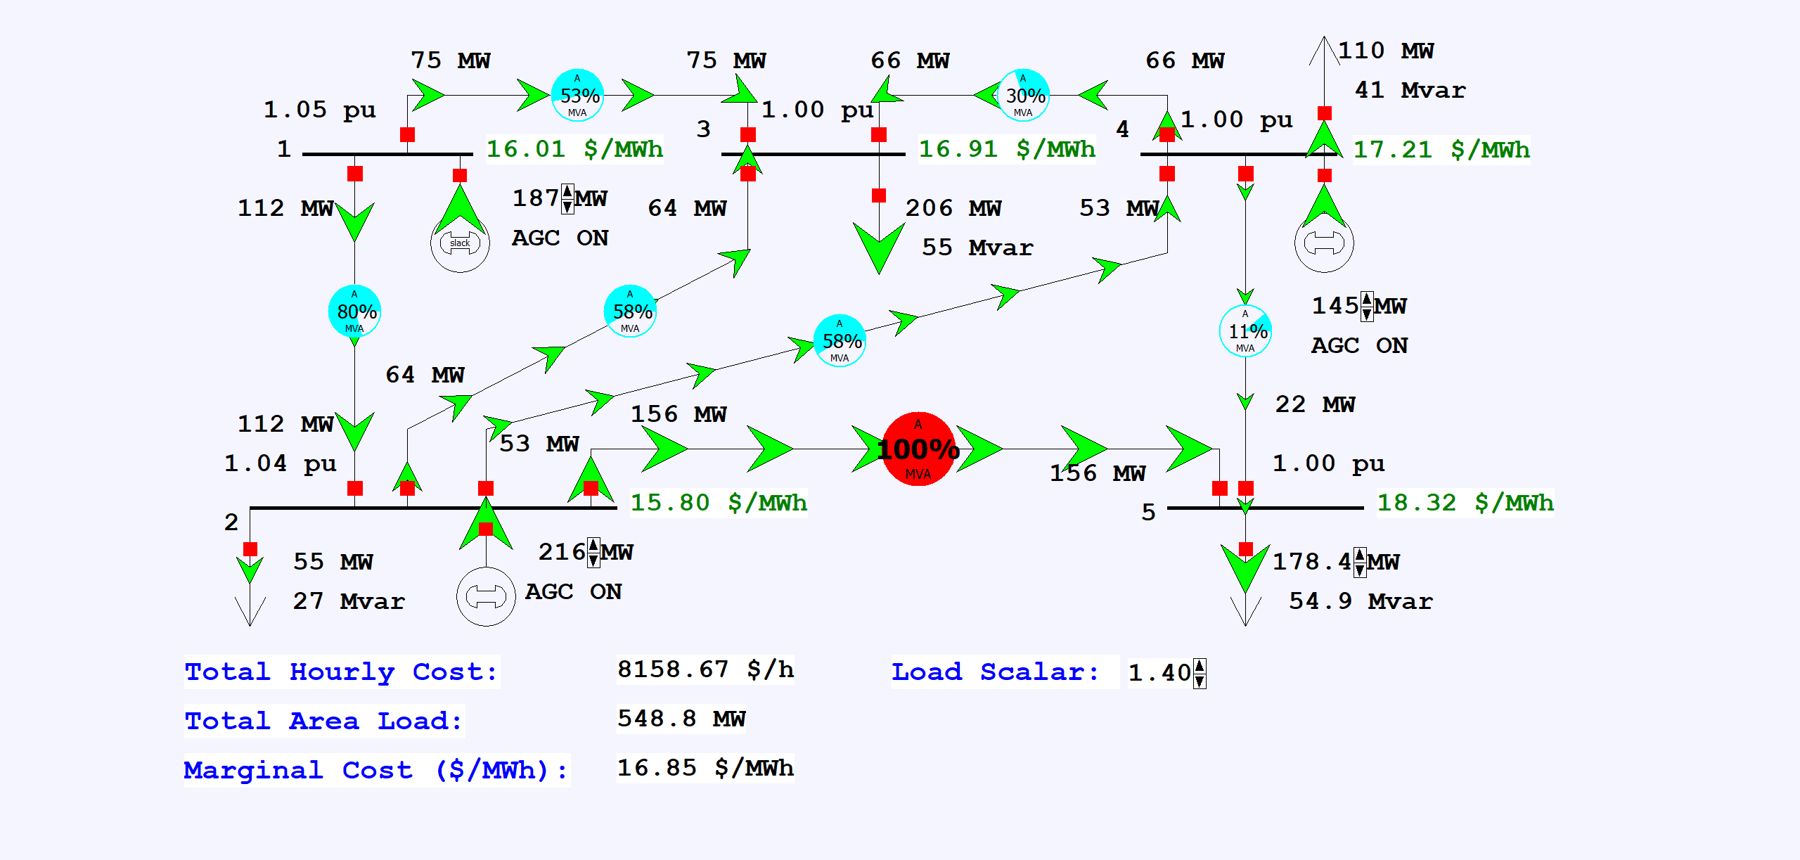
Five Bus Case Optimal Power Flow Example
Load the case B5_OPF. Start the simulation and gradually increase the load; watch the variation in the LMP values
In Simulator a case can be automatically solved using the OPF by 1) setting the area AGC Status to OPF, and 2) in Simulator Options, Environment page setting the Play Animation/Solution Method to Optimal Power Flow
35

Slide 37
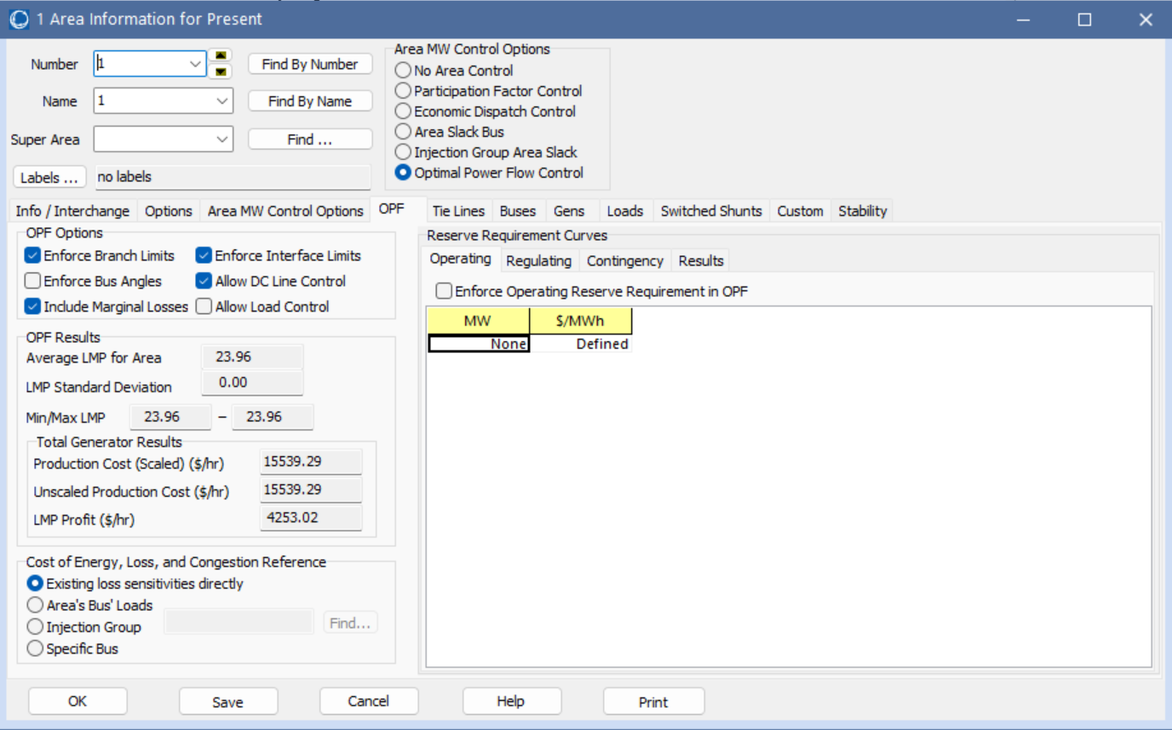
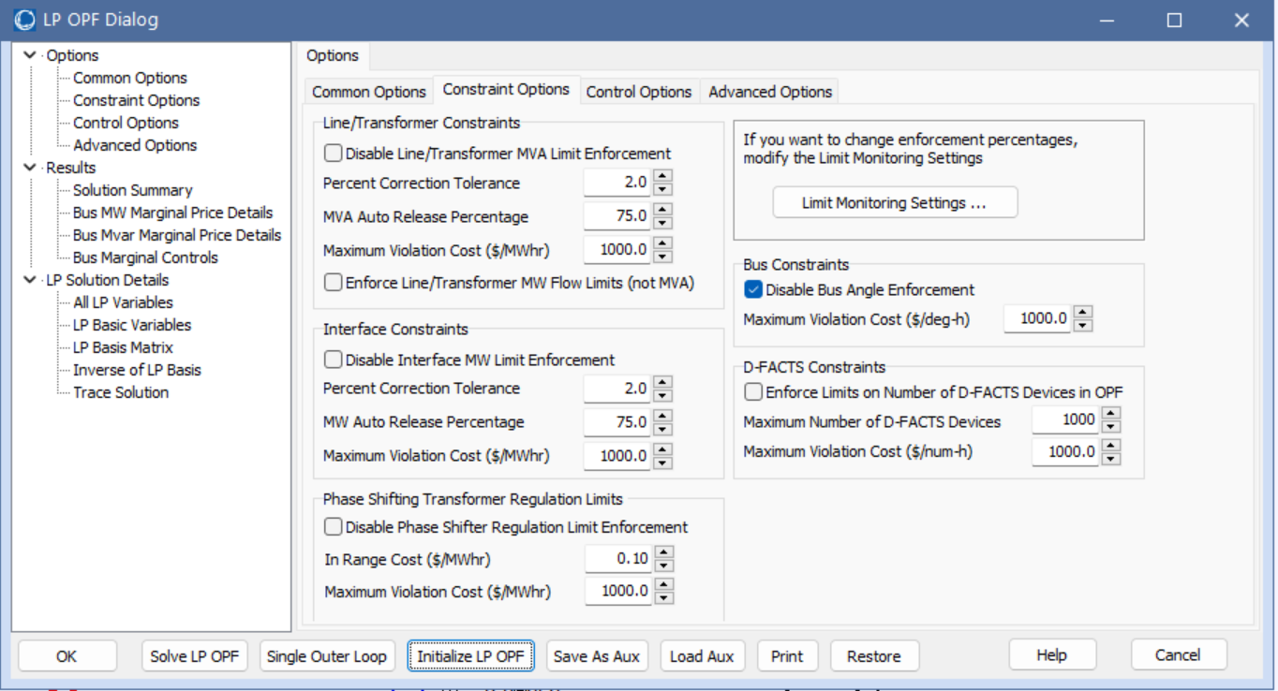
Solving the OPF in Planning Software
When solving an OPF in any planning software there will likely be lots of options; key values control 1) which constraints to enforce, and 2) which controls to use to enforce those constraints
In Simulator some options are available by selecting Add Ons, OPF Case Info, OPF Options and Results; other options are available on the OPF page of the Area Information dialog

Slide 38
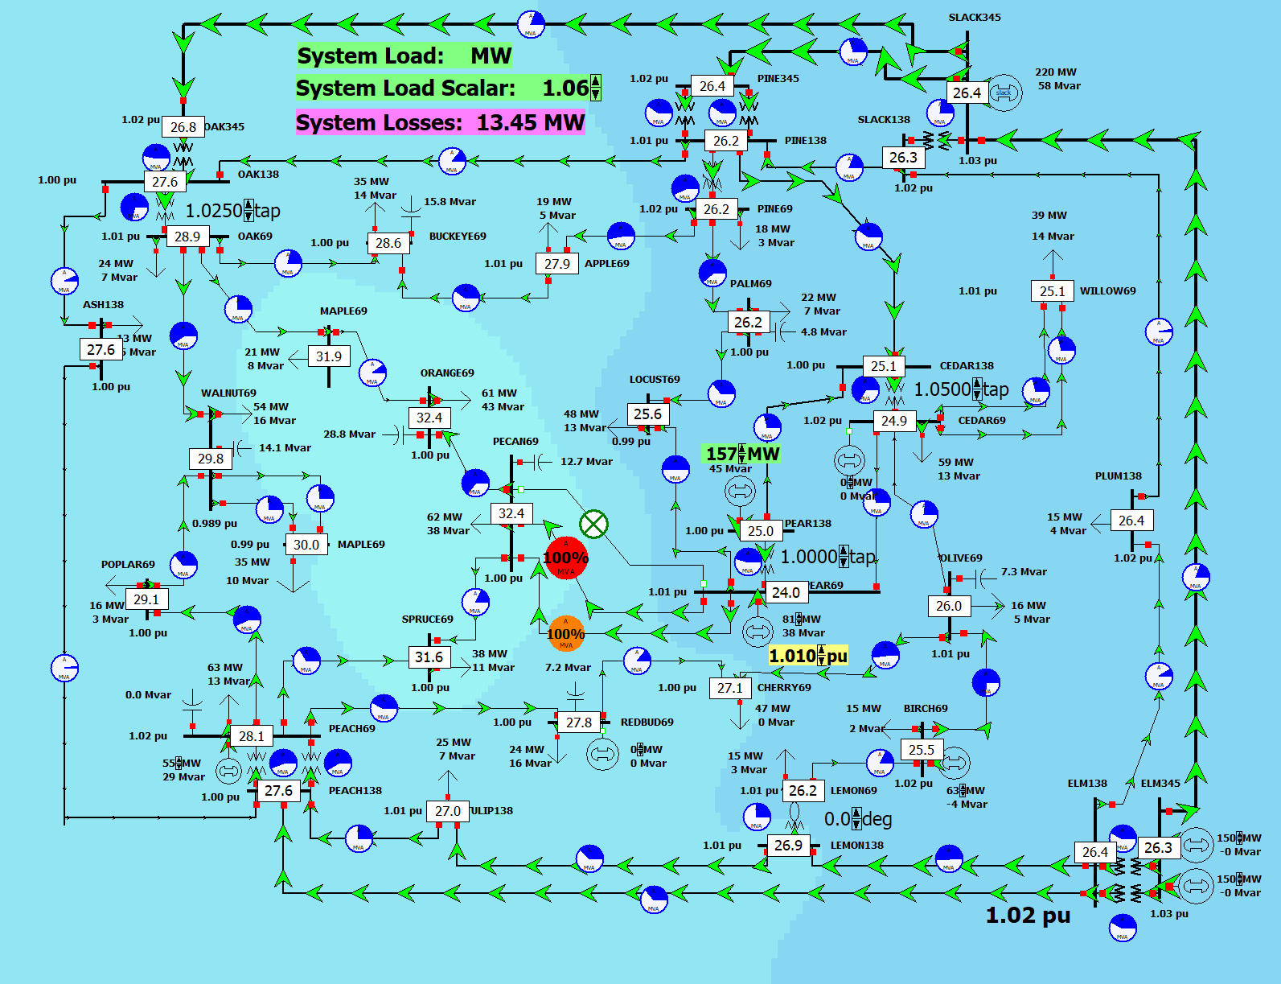
37 Bus Example
Repeat the previous example with the PSC_37Bus_OPF case; if desired display the contour to show the LMPs; try opening one or two of the lines between buses PEAR69 and PECAN69 (the white boxes show the bus LMP values)

Slide 39
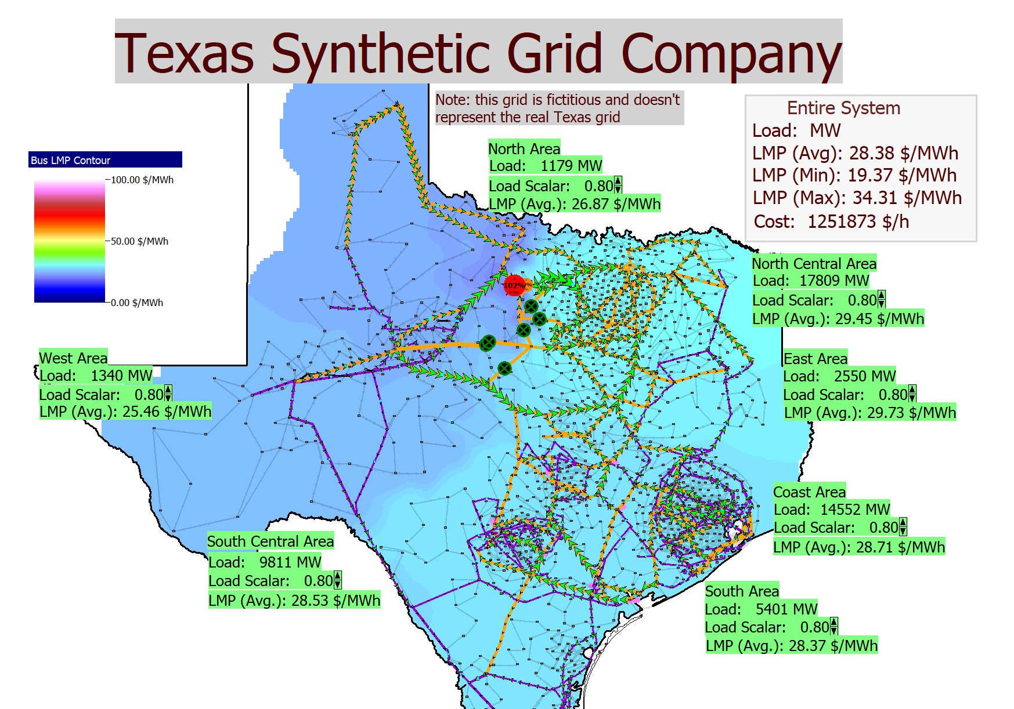
OPF Hands-On: PSC_2000_DCOPF
The OPF (and related security-constrained OPF that we’ll cover shortly) can be a useful planning tool to explore the system capacities assuming it was operated optimally
This can be done using either an ac or a dc power flow
Open the case PSC_2000_DCOPF
This has been setup to automatically solve a DC OPF, with the color contour showing the marginal costs
Right-click on a blank area of the oneline and select Contouring to show an LMP contour
Vary the load in an area (e.g., North Central) and note the variation in the LMPs and congested lines

Slide 40
Security Constrained OPF
Security constrained optimal power flow (SCOPF) is similar to OPF except it also includes contingency constraints
Again the goal is to minimize some objective function, usually the current system cost, subject to a variety of equality and inequality constraints
This adds significantly more computation, but is required to simulate how the system is actually operated (with N-1 reliability)
A common solution is to alternate between solving a power flow and contingency analysis, and an LP

Slide 41
Security Constrained OPF, cont.
With the inclusion of contingencies, there needs to be a distinction between what control actions must be done pre-contingent, and which ones can be done post-contingent
The advantage of post-contingent control actions is they would only need to be done in the unlikely event the contingency actually occurs
Pre-contingent control actions are usually done for line overloads, while post-contingent control actions are done for most reactive power control and generator outage re-dispatch

Slide 42
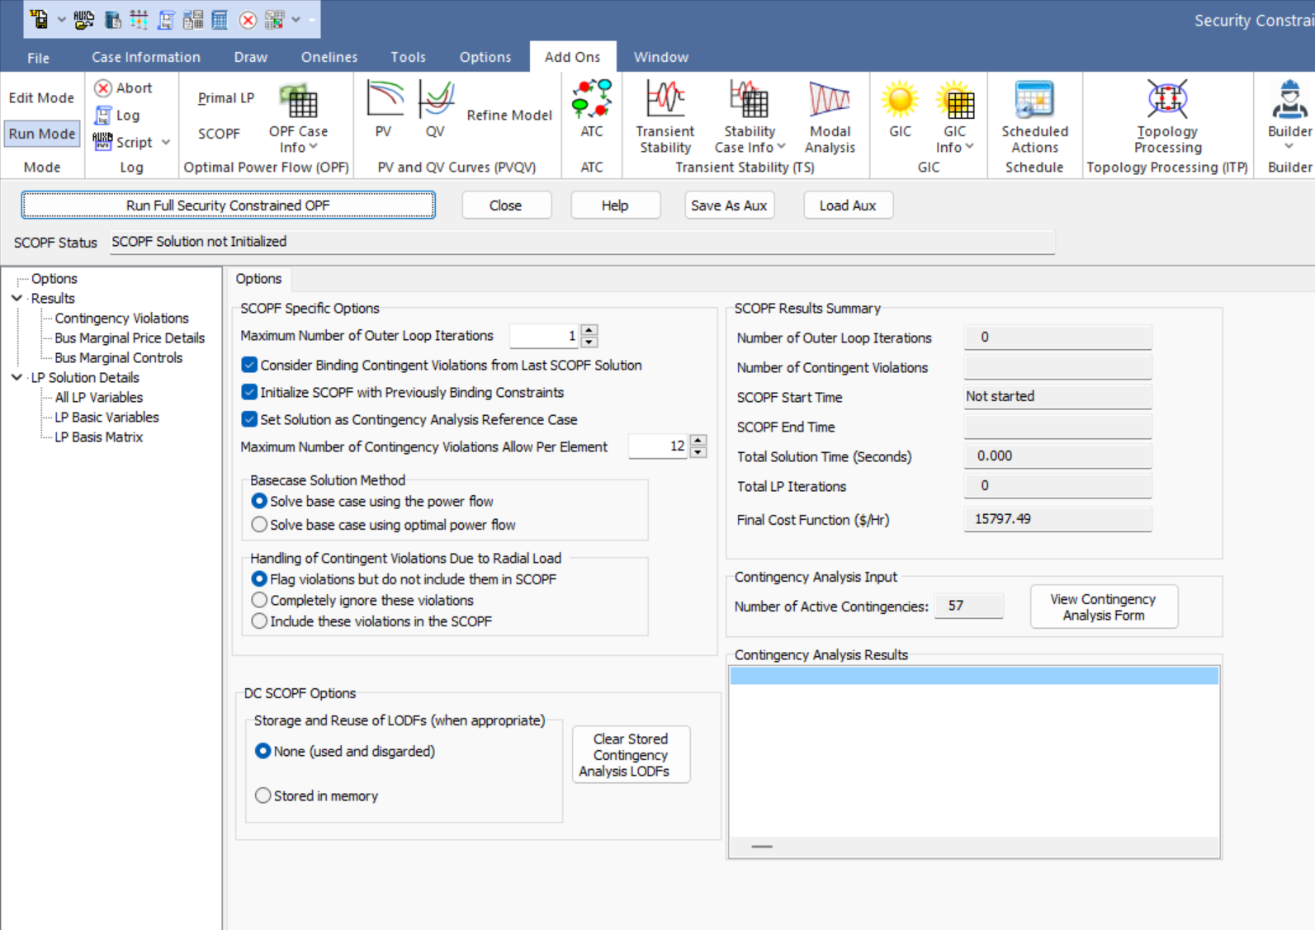
PowerWorld SCOPF Application
To see the PowerWorld SCOPF application, first the PSC_37BusOPF case; then select Tools, Contingency Analysis to verify that some contingencies have been defined
On the Contingency Analysis form click Start Run to do the contingency analysis; verify there are some violations
Select Add Ons, SCOPF to open the SCOPF
Click Run Full Security Constrained OPF

Slide 43
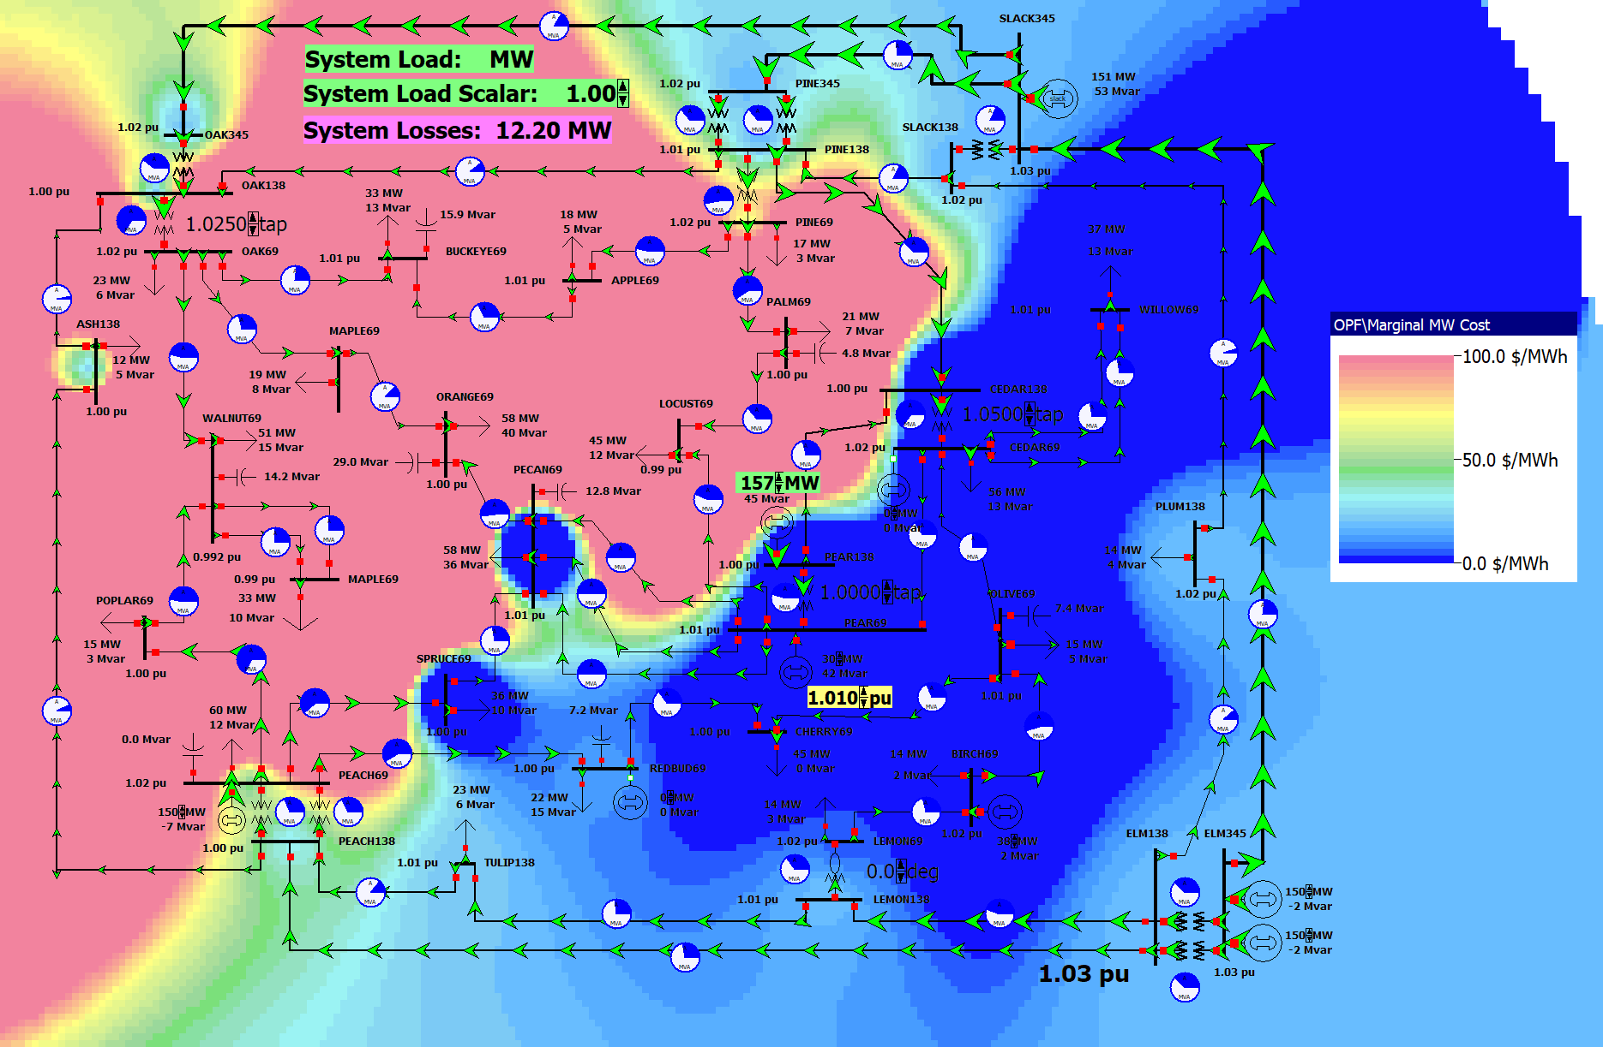
37 Bus Case SCOPF Results
Keeping the SCOPF form open, contour the bus LMPs
What had been a relatively boring OPF solution indicates some major issues
Looking at the SCOPF form Results, Contingency Violations indicates there are some contingencies with unenforceable constraints

Slide 44
LP OPF and SCOPF Issues
The LP approach is widely used for the OPF and SCOPF, particularly when implementing a dc power flow approach
A key issue is determining the number of binding constraints to enforce in the LP tableau
Enforcing too many is time-consuming, enforcing too few results in excessive iterations
The LP approach is limited by the degree of linearity in the power system
Real power constraints are fairly linear, reactive power constraints much less so

Slide 45
Additional OPF and SCOPF Solution Methods
There are several additional approaches for solving the OPF and SCOPF
It continues to be an area of active research
More general commercial optimization packages are being applied to the problem, including Gurobi and CPLEX
Over the years there has been great progress in this area, including with the solution of mixed-integer programming problems (speedups of up to 1 million times have been reported since 1991 with new algorithms and faster computers)

Slide 46
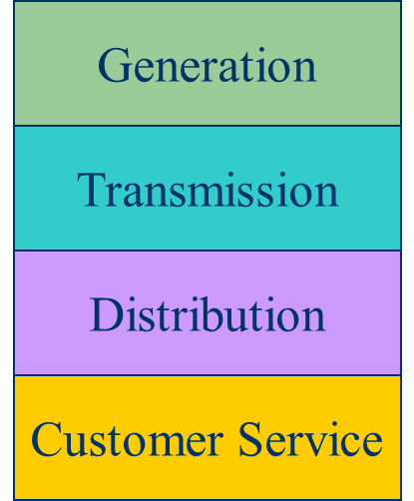
Electricity Markets History
For decades electric utilities operated as vertical monopolies, with their rates set by state regulators
Utilities had an obligation to serve and customers had no choice
There was little third party generation
Major change in US occurred in 1992 with the National Energy Policy Act that mandated utilities provide “nondiscriminatory” access to the high voltage grid
Goal was to setup true competition in generation

Slide 47
Markets Versus Centralized Planning
With the vertically integrated utility, a small number of entities (typically utilities) did most of the planning
For example, which new generators and/or lines to build
Planning was coordinated and governed by regulators
Regulators needed to know the utilities actual costs so they could provide them with a fixed rate of return
With markets the larger number of participants often make individual decisions in reaction to prices
For example, whether to build new generation
Generator owners in general to not need to reveal their true costs; rather they make offers into the market

Slide 48
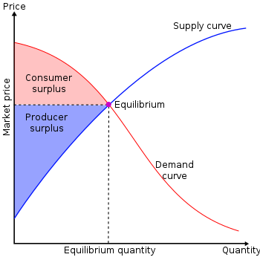
Overall Goal
Goal is to maximize the economic surplus (or total welfare), which is the sum of the consumer surplus and the producer surplus (i.e., their profit)
Generation owners have to decide their offer prices
If their price is too high, they are not selected to generate
At the wholesale level, the consumers often just see a price, though there can be price responsive load bids
Image Source: en.wikipedia.org/wiki/Economic_surplus#/media/File:Economic-surpluses.svg

Slide 49
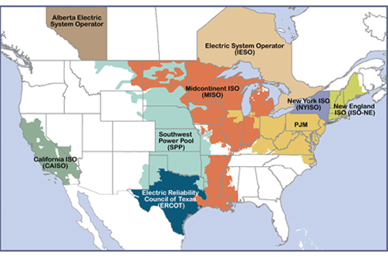
Electricity Markets Today in North America
Starting in about 1995 electricity markets gradually started to develop, both in the US and elsewhere
In North America more than 60% of the load is supplied via wholesale electricity markets; markets differ but they all have certain common features
The terms regional transmission organizations (RTOs) and independent system operators (ISOs) are used (RTOs are more functionality and most are actually RTOs
Image source: www.ferc.gov/industries-data/electric/power-sales-and-markets/rtos-and-isos

Slide 50
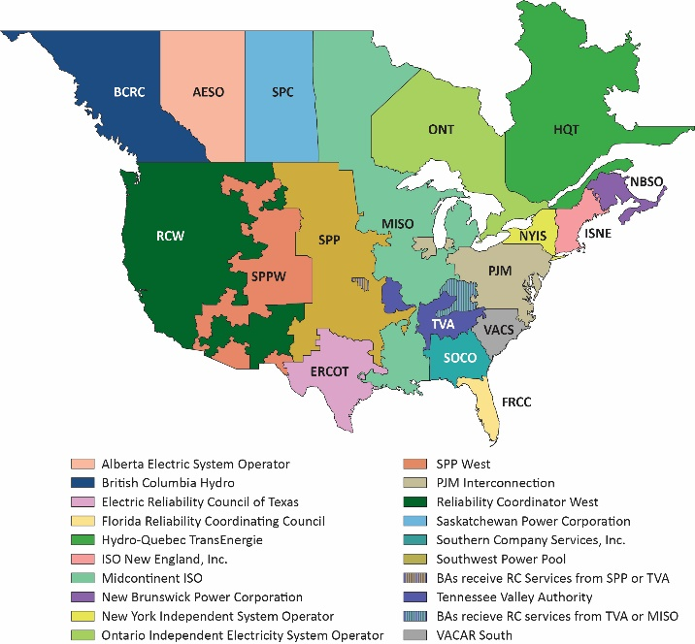
Aside: NERC Reliability Coordinators (RCs)
As noted in NERC IRO-001-1, “Reliability Coordinators must have the authority, plans and agreements in place to immediately direct reliability entities within the Reliability Coordinator Areas to re-dispatch generation, reconfigure transmission, or reduce load to mitigate critical conditions to return the system to a reliable state.”

Slide 51
Electricity Markets Common Features
Day ahead market – this is needed because time is required to make decisions about committing generators
Generation owners submit offers for how much generation they can supply and at what price; accepted offers are binding
Real-time energy market – needed because day ahead forecasts are never perfect, and unexpected events can occur
Co-optimization with other “ancillary services” such as reserves
The source for much of this material “Analytic Research Foundations for the Next-Generation Electric
Grid” (Chapter 2), The National Academies Press, 2016 (free download available)

Slide 52
Electricity Markets Common Features
Pricing is done using locational marginal prices, determined by an SCOPF
Most markets include a marginal losses component
LMP markets are designed to send transparent price signals so people can make short and long-term decisions
Generators are free to offer their electricity at whatever price they desire; they do not have to reveal their “true” costs
Most of the times markets work as planned (competitive prices)
During times of shortages (scarcity) there are limits on LMPs; ERCOT’s had been $9000/MWh prior to Uri; now it is $5000/MWh
Markets are run by independent system operators (ISOs)

Slide 53
LMP Energy Markets
In an LMP energy market the generation is paid the LMP at the bus, and the loads pay the LMP at the bus
This is done in both the day ahead market and in the real-time market (which makes up the differences between actual and the day ahead)
The generator surplus (profit) is the difference between the LMP and the actual cost of generation
Generators that offer too high are not selected to run, and hence make no profit
A key decision for the generation owners is what values to offer

Slide 54
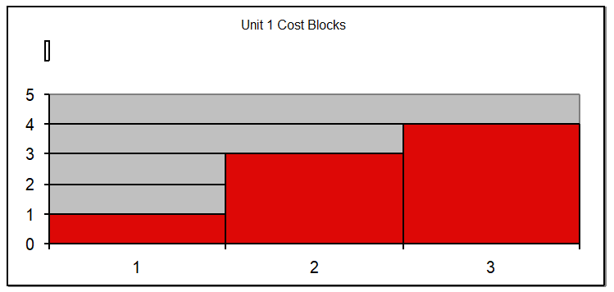
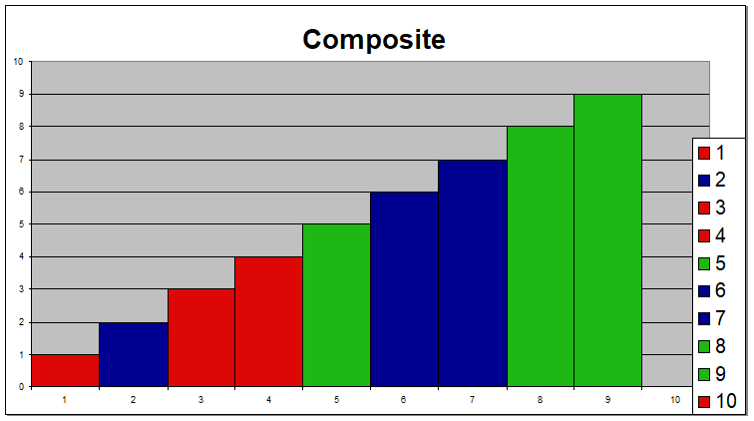
Generator Offers
Generator offers are given in piecewise linear curves; that is, a fixed $/MWh for so much power for a time period
In the absence of constraints (congestion) the ISO would just select the lowest offers to meet the anticipated load
Actual dispatch is determined using an SCOPF

Slide 55
General Guidelines
Generators with high fixed costs and low operating costs (e.g., wind, solar, nuclear) benefit from running many hours
Usually they should submit offers close to their marginal costs
Wind (and some others) receive a production tax credit (PTC) for their first ten years of operation
$23/MWh for systems starting construction before 1/1/2017
$18/MWh 2017, $14/MWh in 2018, $10/MWh in 2019
It was suppose to end in 2019, but was extended in 12/2019 through 2020 at $15MWh
Then it got extended through the end of 2021 at $18/MWh
On 8/16/22 President Biden signed the Inflation Reduction Act of 2022 that extended the PTC through at least 2024 and provides 100% for certain projects
Generators with low fixed costs and high operating cost can do fine operating fewer hours (at higher prices)

Slide 56
Horizontal Market Power
One issue is whether a particular group of generators has market power
Market power is the antithesis of competition
It is the ability of a particular group of sellers to maintain prices above competitive levels, usually by withholding supply
The extreme case is a single supplier of a product (i.e., a monopoly)
In the short run what a monopolistic producer can charge depends upon the price elasticity of the demand
Sometimes market power can result in decreased prices in the long-term by quickening the entry of new players or new innovation

Slide 57
Market Power and Scarcity Rents
A generator owner exercises market power when it is unwilling to make energy available at a price that is equal to that unit’s variable cost of production, even thought there is currently unloaded generation capacity (i.e., there is no scarcity)
Scarcity rents occur when the level of electric demand is such that there is little, if any, unused capacity
Scarcity rents are used to recover fixed costs
If in an LMP market the participants can make offers for their generation and if they are paid the bus LMP, then there is the potential to do profit maximization; profit maximization can be done as long as a particular participant does not have market power

Slide 58
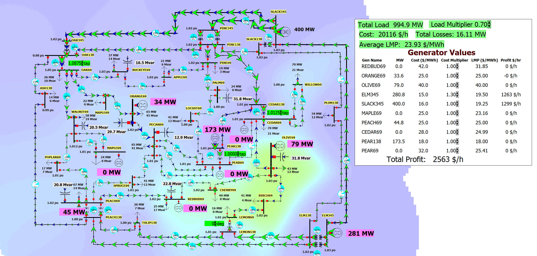
37 Bus Profit Maximization Example
To try maximizing profits, open the case PSC_37Bus_SCOPF and change the cost multiplier for one or more generators

Slide 59

Thank You! Questions?
58

